Slide 1
The Challenge of Inclusive Agricultural Growth: Promoting participation of the poor
Lena Heron
USAID Bureau of Food Security
September 2011

Slide 2
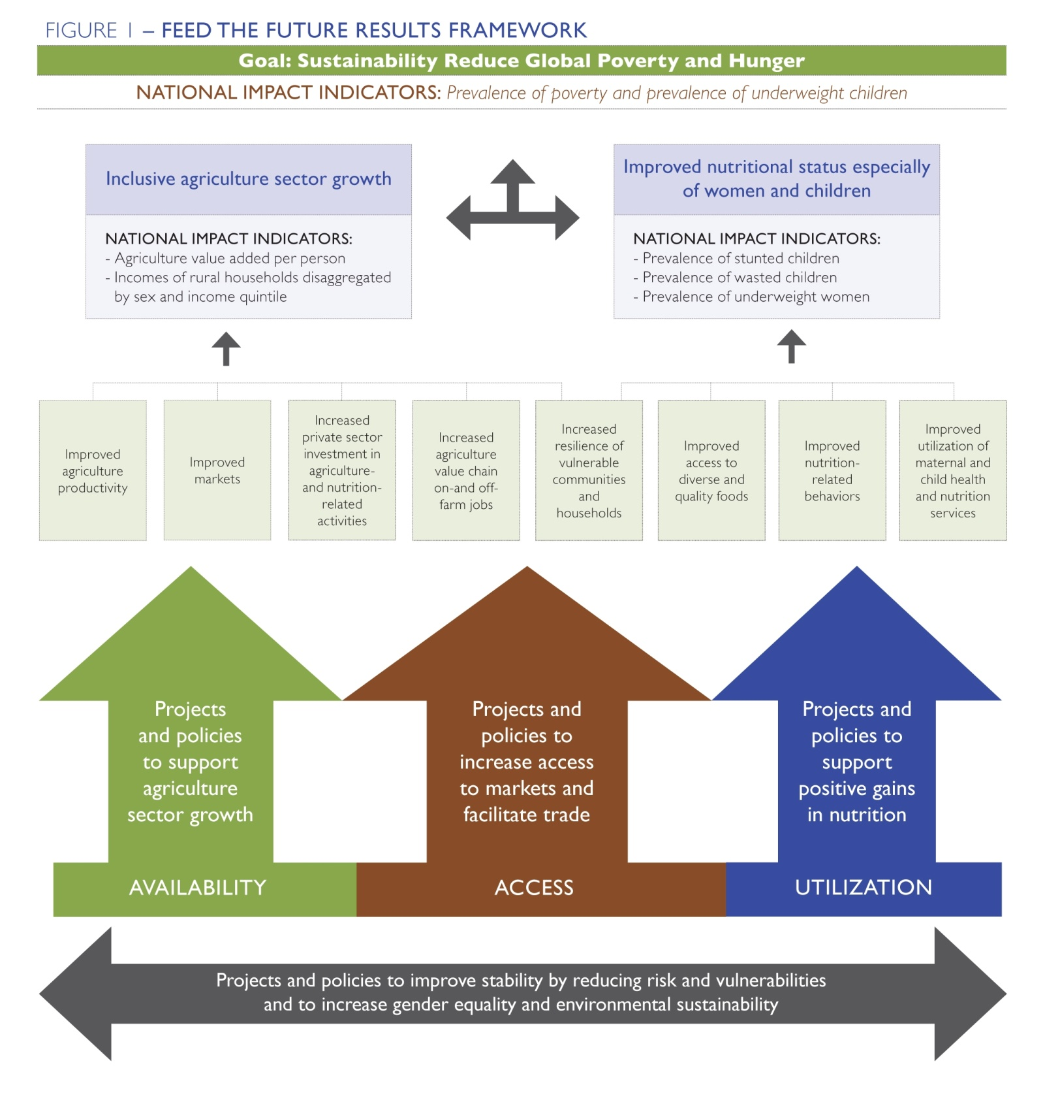

Slide 3
In the context of Feed the Future:
Inclusive Agriculture-led Growth. . .
. . . is an acknowledgement that food security will require enhanced participation of the very poor in expanding rural economies.
But for this, we need to know:
Who are the poor?
Why are they poor?
And why do they stay poor?
Notes:
Growth is necessary for poverty reduction but not sufficient.
Constraints to poorer households’ participation in agricultural growth will vary significantly from one country to the next but fair to say that -
“integrating poor households into new economic opportunities associated with agricultural growth presents several challenges.”

Slide 4
Who are the poor?
Rural poor are generally dependent on agricultural for their livelihoods—they may produce their own food, and may even have some marketable surplus; they may also seek casual employment on others farms.
May (Asia) or may not (Africa and LAC) be landless;
Two billion smallholders with farms of 2 hectares or less;
Using family labor;
Producing for own consumption, yet net food buyers.
From IFPRI (2007), “The World’s Most Deprived.”
Notes:
The poor are more rural and the rural are more poor. . .
May (Asia) or may not (Africa and LAC) be landless;
Two billion smallholders with farms of 2 hectares or less;
Most using family labor;
Producing for own consumption, yet net food buyers;
Low levels of education; and
Poor access to markets, services, information.

Slide 5
Why are they poor?
Poor households often have far fewer productive assets, such as land or traction animals.
Low levels of skills and education are often a constraint.
They generally have weaker access to markets, services, information, or are otherwise marginalized from economic activity.
All of these things make poor populations more vulnerable to shocks such as drought, conflict and economic downturns.
Notes:
Ask about examples of social exclusion – gender
Women
rarely have control over the resources they use
have limited voice in decision-making organizations
have less access to support services, such as inputs, technologies or advice (few extension agents are women and women may face obstacles getting credit)
have less time as caregivers to get everything done

Slide 6
Why do they stay poor?
The poor. . .
…often view investment or livelihood decisions differently from those less vulnerable.
…tend to prioritize strategies that minimize risk rather than maximize income.
. . .may diversify income streams rather than specializing in a higher return activity.
…forego opportunities with longer payback periods or slower capital rotation which are viewed as much more risky.
Notes:
Ask what the implications of this will be for pursuing new economic opportunities

Slide 7
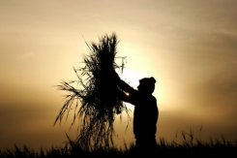
What’s wrong with this picture?
Notes:
AS number of years ago, a colleague circulated a picture of a wheat farmer in his field and asked “what’s wrong with this picture?” After several responses (no women in the picture, low levels of mechanization, etc.), someone finally identified that the picture was of a field full of an old, low-yielding variety of wheat.
But WHY? Is it a problem of extension? (He doesn’t know about it?)
Or markets? (He can’t buy the seeds?)
What about access to FINANCE? Can he get a loan to buy the improved seeds?
Would he take a loan even if he could get one? Can he afford to take the risk?

Slide 8
What needs to be done?
Improving capacity to manage risk
Facilitating acquisition of productive assets (including skills)
Improving access/entry points to opportunities in agricultural growth/expanded rural economies:
As producers;
As employees in value chain firms;
As micro-service providers
So how best do we do these things?
Notes:
NGO programming, including that under FFP, PEPFAR and others is ongoing That’s why researchers where able to do rigorous impact evaluation of activities
Mission programming under FTF
If those programs weren’t already operating, we wouldn’t have the research findings that we have today on impacts. . .
Report out on the findings, use the findings to better understand how to design and refine programming. . .

